Slide 2
The Master Theorem
Given: a divide and conquer algorithm
An algorithm that divides the problem of size n into a subproblems, each of size n/b
Let the cost of each stage (i.e., the work to divide the problem + combine solved subproblems) be described by the function f(n)
Then, the Master Theorem gives us a cookbook for the algorithm’s running time:

Slide 3
The Master Theorem
if T(n) = aT(n/b) + f(n) then

Slide 4
Using The Master Method
T(n) = 9T(n/3) + n
a=9, b=3, f(n) = n
n^{logb a} = n^{log3 9} = Θ(n²)
Since f(n) = O(n^{log3 9 - ε}), where ε=1, case 1 applies:
Thus the solution is T(n) = Θ(n²)

Slide 5
2. T(n) = T(2n/3) + 1 a= 1 b = 3/2 f(n) = 1 -> n raise 0 ->1 => log(n) case 2
3. T(n) = 3T(n/4) + nlogn a=3, b=4 n raise to 0.75 ->case3 => theta(nlogn)
4. T(n) = 2T(n/2) + Θ(n) ; a=2, b=2 =>case 2 => theta(nlogn)
5. T(n) = 8T(n/2) + Θ(n²) ; a=8, b=2 ->n cube => case 1=> theta(n cube)
6. T(n) = 7T(n/2) + Θ(n²) ; a=7, b=2 =>case 1=> theta(n raise to log7 to base 2)

Slide 6
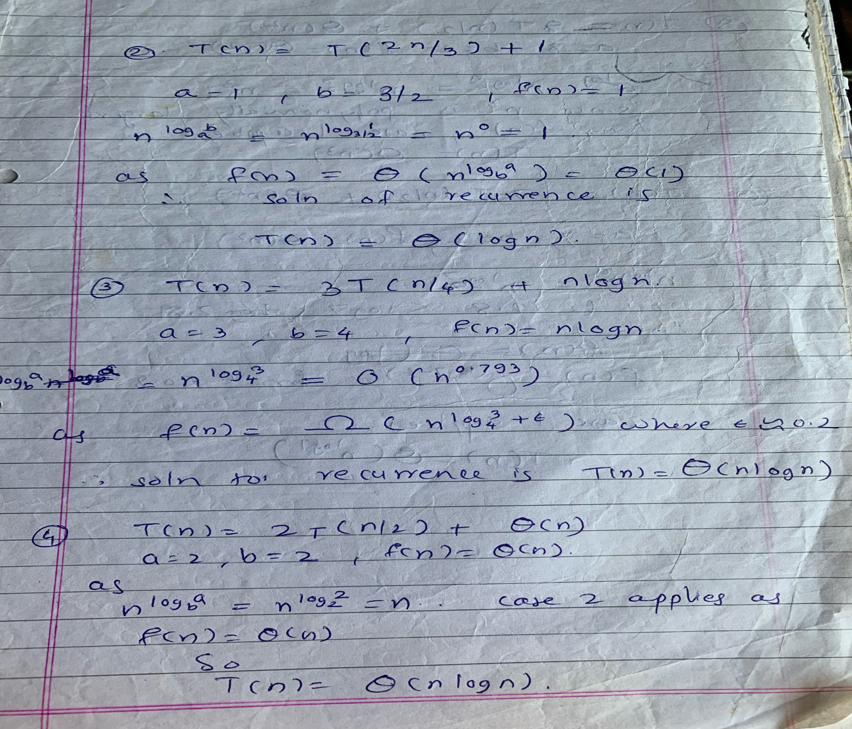

Slide 7
